Slide 1

TRUTHS ABOUT PASTOR
Jeremiah 3:15 Hebrews 13:7,17
Pastor Rod M. Lago

Slide 2
I. THEY ARE GIFT FROM GOD.

Slide 3
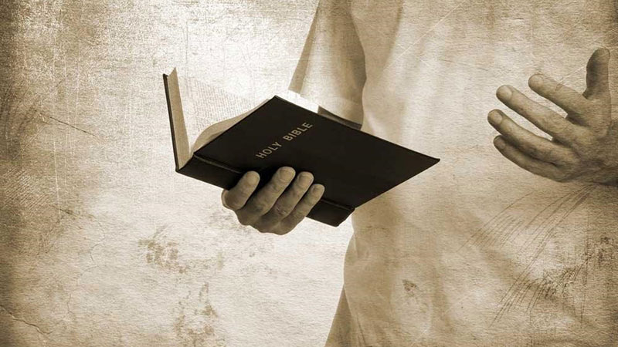
Jeremiah 3:15(KJV)
And I will give you pastors according to mine heart, which shall feed you with knowledge and understanding.

Slide 4
II. THEY ARE
LEADER FROM GOD.

Slide 5

Hebrews 13:7(NIV)
Remember your leaders, who spoke the word of God to you. Consider the outcome of their way of life and imitate their faith.

Slide 6
a. A Man of Prayer, not just for himself, but for his family and for the Church.
b. A Man who studies the Word of God that he may present Jesus Christ in his Preaching and Teaching as the central theme of the Gospel message.

Slide 7
c. A Man who Patterns his life after the Life of Jesus Christ so he may be example of Jesus Christ before his Congregation.

Slide 8

Picture ng nagbigti na Pastor.

Slide 9
III. THEY ARE
ACCOUNTABLE TO GOD.

Slide 10

Hebrews 13:17(NIV)
Have confidence in your leaders and submit to their authority, because they keep watch over you as those who must give an account. Do this so that their work will be a joy, not a burden, for that would be of no benefit to you.

Slide 11
CHURCH RESPONSIBILITIES:
1. To Put your Confidence to your Pastor.
* meaning to give your Trust to your Pastor.
2. Submit to his Authority.
* meaning you will obey him without any form of complaining and Murmuring.

Slide 12
Pastor’s Responsibilities
1. We keep watch over you.
* We are Protecting you from any form of wolves as a shepherd.
2. A Person of Trust and Submissive to Christ.
* So that if you put your confidence in us and submit to us the result of our work will be a Joyful Ministry and not a Burden Ministry.

Slide 13
“Dapat ang Pastor ay Tinutulungan hindi Pinagtutulungan”

Slide 14

TRUTHS ABOUT PASTOR…
THEY ARE GIFT FROM GOD.
THEY ARE LEADER FROM GOD.
THEY ARE ACCOUNTABLE TO GOD.

